Slide 1

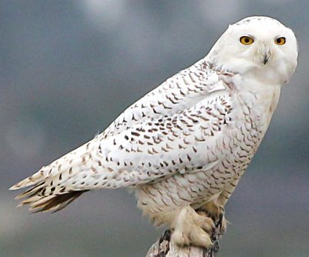
algo-owls
Team Members:
Christian –
Underlying strategy
Jonathan –
Project Plan
Carolina –
Random Forest Metrics
Mark –
LSTM Metrics
January 16th 2021

Slide 2
The Strategy
We aim at anticipating market moves by identifying squeezes that precedes them.
We aim at using 2 EMAs crossovers to anticipate their crossovers for direction predictions.

Slide 3
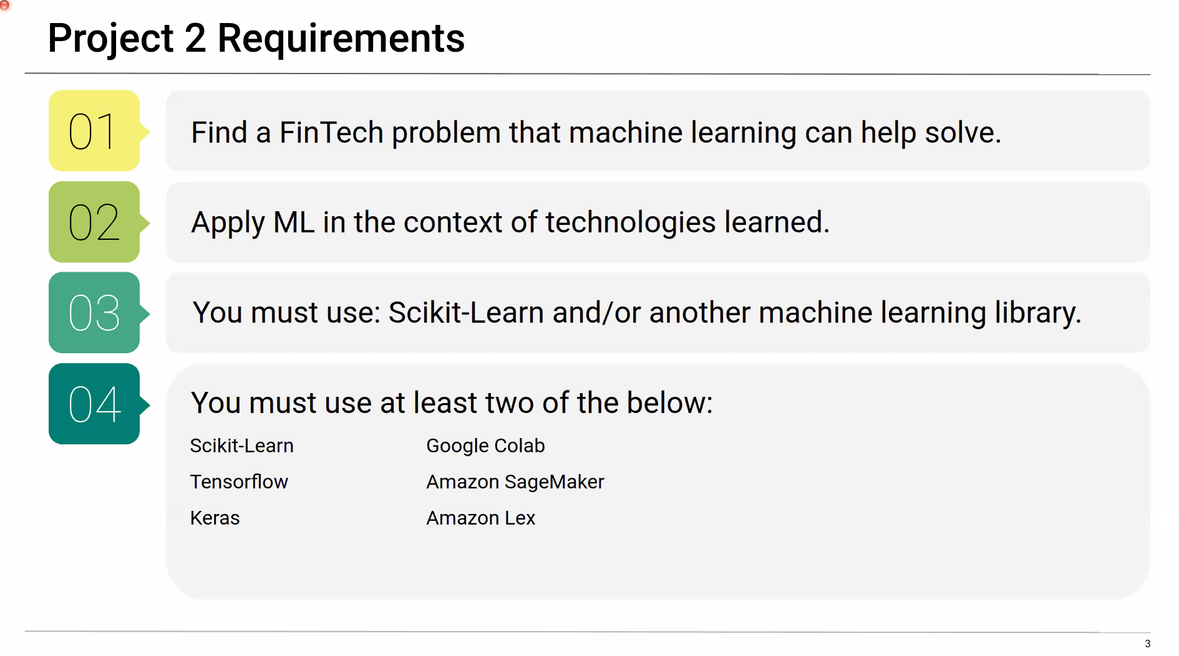
Project Objectives
REQUIREMENTS
OUR SCOPE OF WORK
Build one Machine Learning Model to predict the squeeze breakout and breakout direction.
Use at least two of the libraries specified below:

Slide 4
Project Objectives
REQUIREMENTS
OUR SCOPE OF WORK
Build one Machine Learning Model to predict the squeeze breakout and breakout direction.
Use at least two of the libraries specified below:
Build a Machine Learning system comprised of 4 Machine Learning Models:
2 Random Forests Classifiers (squeeze and EMAs crossover)
1 LSTM Binary
1 LSTM price predictor (price entry)

Slide 5
Project Objectives
REQUIREMENTS
OUR SCOPE OF WORK
Build one Machine Learning Model to predict the squeeze breakout and breakout direction.
Use at least two of the libraries specified below:
Build a Machine Learning system comprised of 4 Machine Learning Models:
2 Random Forests Classifiers (squeeze and EMAs crossover)
1 LSTM Binary
1 LSTM price predictor (price entry)
Analyze each ML Performance with analytics and metrics.
Libraries and applications:
Scikit-Learn
TensorFlow
Keras

Slide 6
PROJECT PLAN
Mod 2:
Feat_func
python
Mod 1:
Data_imp.

Slide 7
PROJECT PLAN
Mod 3:
Feat_func
Python 2
Mod 2:
Feat_func
python
Mod 1:
Data_imp.

Slide 8
PROJECT PLAN
Mod 4:
Feat_func
& y_gene
TS
Mod 3:
Feat_func
Python 2
Mod 2:
Feat_func
python
Mod 1:
Data_imp.

Slide 9
csv input
PROJECT PLAN
Mod 4:
Feat_func
& y_gene
TS
Module 5:
RF for squeeze
Module 6:
RF for Ema’s
Mod 3:
Feat_func
Python 2
Mod 2:
Feat_func
python
Mod 1:
Data_imp.

Slide 10
csv input
PROJECT PLAN
Mod 4:
Feat_func
& y_gene
TS
Module 5:
RF for squeeze
Module 6:
RF for Ema’s
Mod 3:
Feat_func
Python 2
Selective Function
Module 7
LSTM binary
Mod 2:
Feat_func
python
Mod 1:
Data_imp.

Slide 11
csv input
PROJECT PLAN
Mod 4:
Feat_func
& y_gene
TS
Module 5:
RF for squeeze
Module 6:
RF for Ema’s
Mod 3:
Feat_func
Python 2
Selective Function
Module 7
LSTM binary
Mod 2:
Feat_func
python
Module 8
LSTM price entry
Mod 1:
Data_imp.

Slide 12
csv input
PROJECT PLAN
Mod 4:
Feat_func
& y_gene
TS
Module 5:
RF for squeeze
Module 6:
RF for Ema’s
Mod 3:
Feat_func
Python 2
Selective Function
Module 7
Mod 2:
Feat_func
python
Module 8
LSTM price entry
Module 9:
Future Automation
And ML integration
Mod 1:
Data_imp.

Slide 13
Random Forest Metrics
Module 5: Squeeze RF
0
TN: 1002 FN: 316
FP: 494 TP: 892
Actual
1
0
1
Predicted
Precision = 64.36%
Estimators = 1000
Max_depth =25
Relevant Features 60%: bbup, bblo, kcup, kclo and 20sma.

Slide 14
Random Forest Metrics
Module 5: Squeeze RF
Module 6: EMAs cross RF
0
TN: 1002 FN: 316
FP: 494 TP: 892
0
TN: 1876 FN: 20
FP: 758 TP: 50
Actual
Actual
1
1
0
1
0
1
Predicted
Predicted
Precision = 64.36%
Precision = 6.18%
Estimators = 1000
Max_depth =20
Relevant Features 53%: ema_dist, delta, close, ATR and high.
Estimators = 1000
Max_depth =25
Relevant Features 60%: bbup, bblo, kcup, kclo and 20sma.

Slide 15
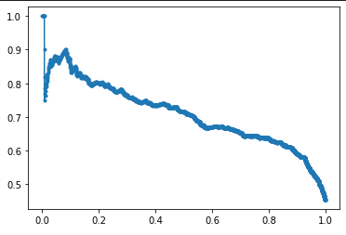
Random Forest Metrics
Module 5: Squeeze RF
Precision
AUC¹: 0.7041
no-skill Classifier
Recall
Acc. Score: 70%
Precision Recall Curve
¹ AUC: Area under the curve

Slide 16
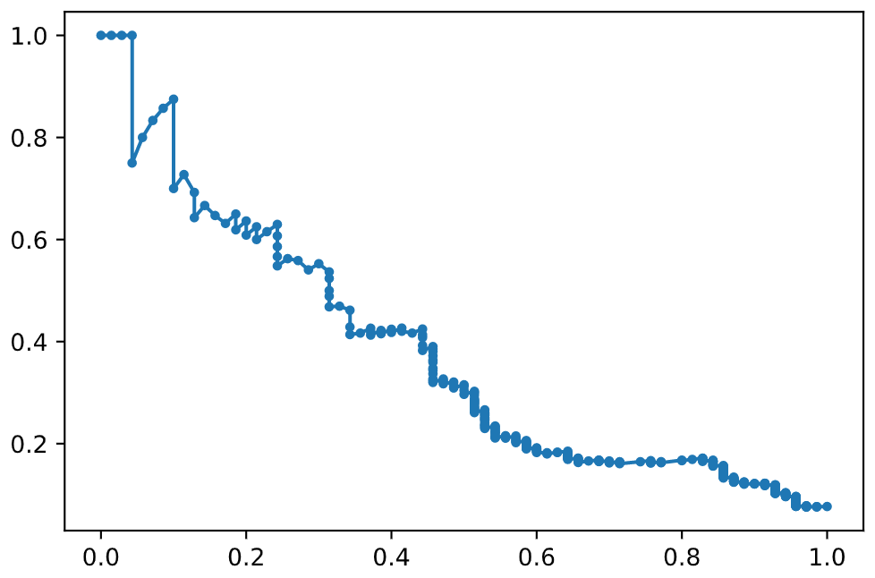
Random Forest Metrics
Module 5: Squeeze RF
Module 6: EMAs cross RF
Precision
Precision
AUC¹: 0.7041
AUC¹: 0.5071
no-skill Classifier
no-skill Classifier
Recall
Recall
Acc. Score: 70%
Acc. Score: 71%
Precision Recall Curve
¹ AUC: Area under the curve

Slide 17
Random Forest – Importance Features
%

Slide 18
Random Forest – Importance Features
%

Slide 19
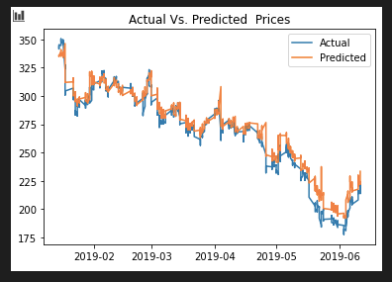
LSTM Metrics
Module 8: Price Entry
USD
Sticker: JPM
Dates
Loss function = 0.00205

Slide 20
Future Developments
Re-assess or reconfigure the EMA random forest to meet precision statistical requirements and improve performance.

Slide 21
Future Developments
Re-assess or reconfigure the EMA random forest to meet precision statistical requirements and improve performance.
Test models with more assets for robust statistics.

Slide 22
Future Developments
Re-assess or reconfigure the EMA random forest to meet precision statistical requirements and improve performance.
Test models with more assets for robust statistics.
Automation / Machine Learning integration
Develop a .py script using Select Function

Slide 23
Future Developments
Re-assess or reconfigure the EMA random forest to meet precision statistical requirements and improve performance.
Test models with more assets for robust statistics.
Automation / Machine Learning integration
Develop a .py script using Select Function
Develop a Machine Learning Model to predict prices 5 or more periods ahead (target price predictor)

Slide 24
Future Developments
Re-assess or reconfigure the EMA random forest to meet precision statistical requirements and improve performance.
Test models with more assets for robust statistics.
Automation / Machine Learning integration
Develop a .py script using Select Function
Develop a Machine Learning Model to predict prices 5 or more periods ahead (target price predictor)
Develop Function that execute trades based on prices forecasted by LSTM price predictors.

Slide 25
Conclusions
LSTM binary model caused barriers to the Machine Learning system.

Slide 26
Conclusions
LSTM binary model caused barriers to the Machine Learning system.
The two random forest classifiers offered 70% or above accuracy score.

Slide 27
Conclusions
LSTM binary model caused barriers to the Machine Learning system.
The two random forest classifiers offered 70% or above accuracy score.
The EMA crossover model needs to be reconfigured to increase precision and to improve the precision-recall curve.

Slide 28
Conclusions
LSTM binary model caused barriers to the Machine Learning system.
The two random forest classifiers offered 70% or above accuracy score.
The EMA crossover model needs to be reconfigured to increase precision and to improve the precision-recall curve.
The squeeze random forest model was able to anticipate the “squeeze” state with a precision of 64%.

Slide 29
Conclusions
LSTM binary model caused barriers to the Machine Learning system.
The two random forest classifiers offered 70% or above accuracy score.
The EMA crossover model needs to be reconfigured to increase precision and to improve the precision-recall curve.
The squeeze random forest model was able to anticipate the “squeeze” state with a precision of 64%.
Tests were limited to one asset and one direction (bullish trades)

Slide 30
algo-owls

Slide 31
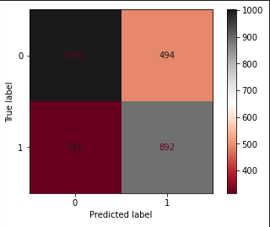
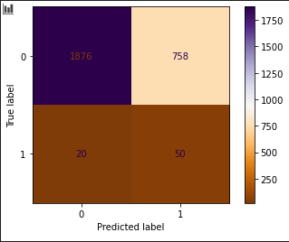
Random Forest Metrics
Module 5: Squeeze RF
Module 6: EMAs cross RF
Estimators = 1000
Max_depth =20
Relevant Features 53%: ema_dist, delta, close, ATR and high.
Acc. Score: 71%
Acc. Score: 70%
Estimators = 1000
Max_depth =25
Relevant Features 60%: bbup, bblo, kcup, kclo and 20sma.

Slide 32
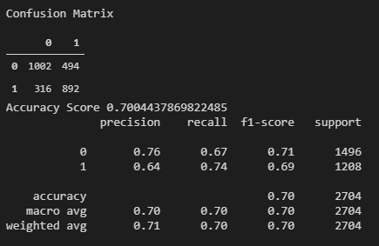
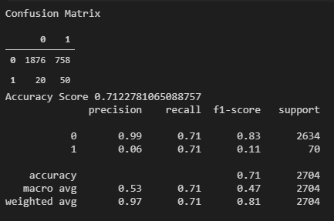
Random Forest Metrics
Module 5: Squeeze RF
Module 6: EMAs cross RF
Precision
Precision Recall Curve
Recall
Precision
Recall

Slide 33
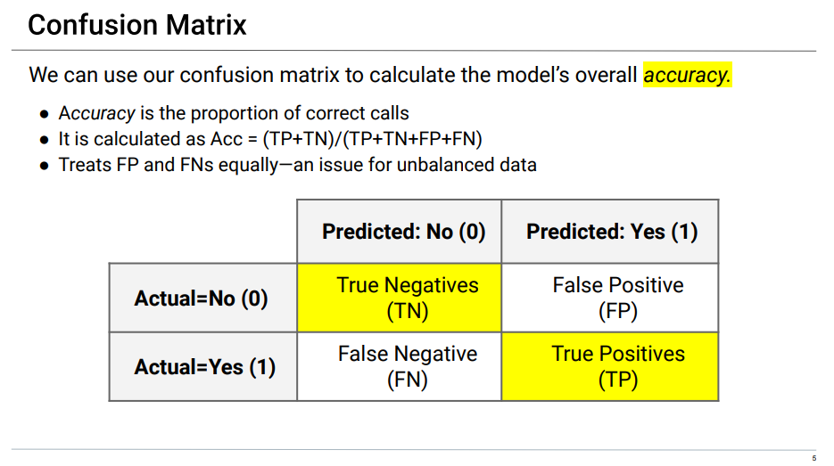
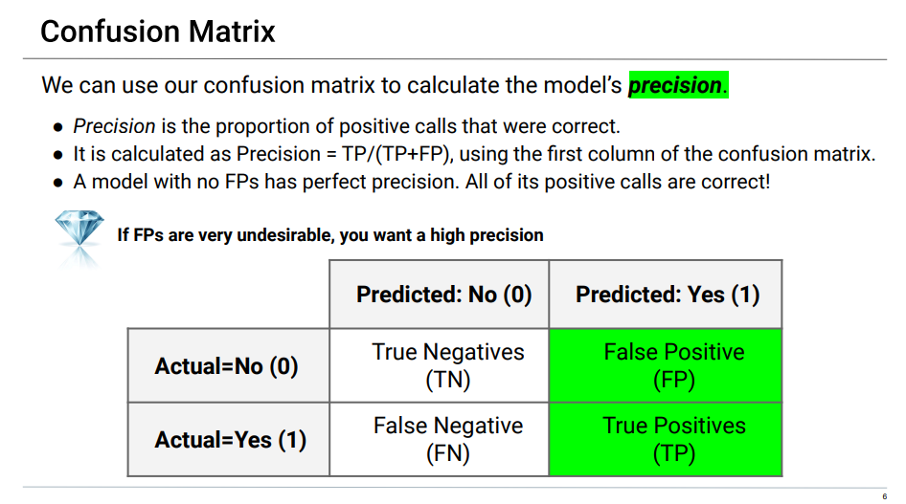
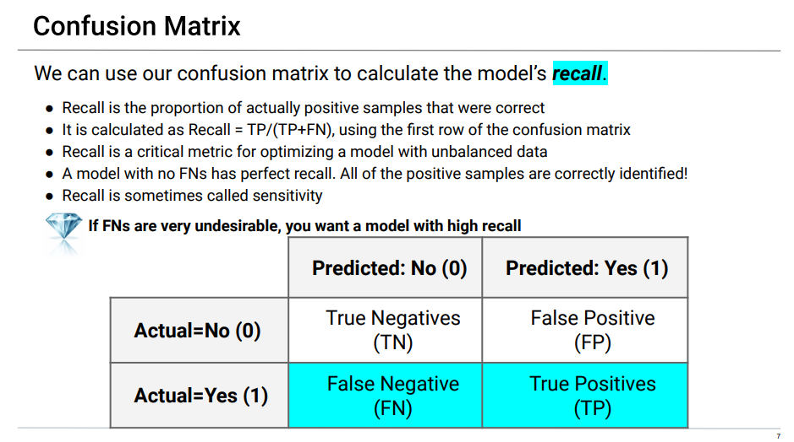
algo-owls

Slide 34
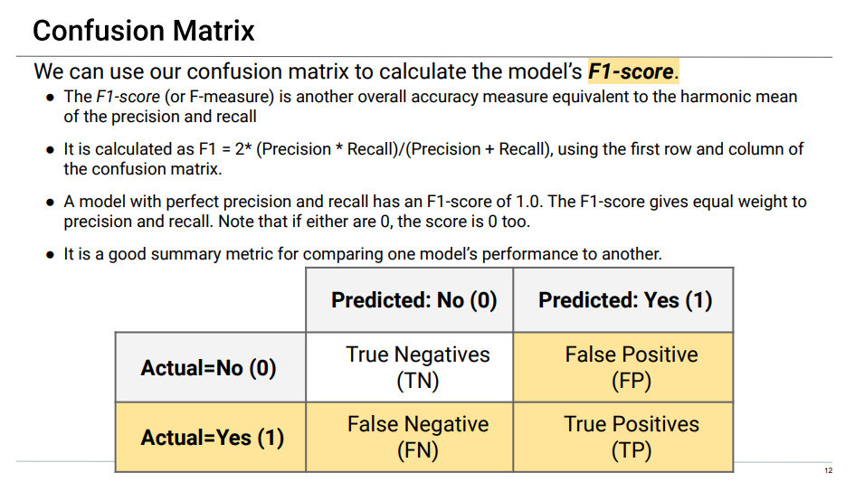
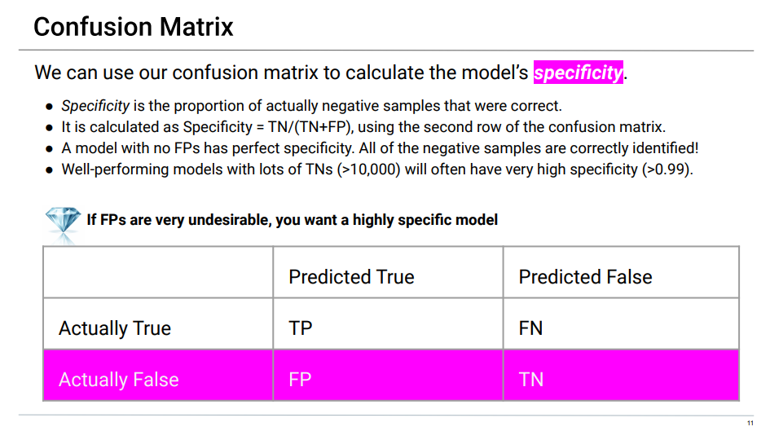
algo-owls

Slide 35
csv input
PROJECT FINAL
Mod 4:
Feat_func
& y_gene
TS
Module 5:
RF for squeeze
Module 6:
RF for Ema’s
RF’s trained & tested
Mod 3:
Feat_func
Python 2
.PY script
Selective Function
Mod 2:
Feat_func
python
Module 8
LSTM price entry
Mod 1:
Data_imp.

